Slide 1
Unsupervised Learning

Slide 2
Contents
Introduction to Unsupervised Learning
Tasks in Unsupervised Learning
Clustering
Dimensionality reduction
Anomaly detection
Association rule mining
Applications of Unsupervised Learning
Clustering and Types of Clustering
K- means Clustering

Slide 3
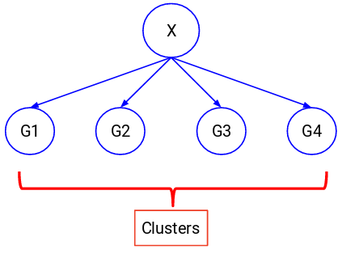
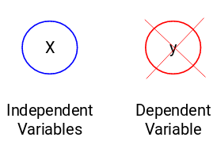
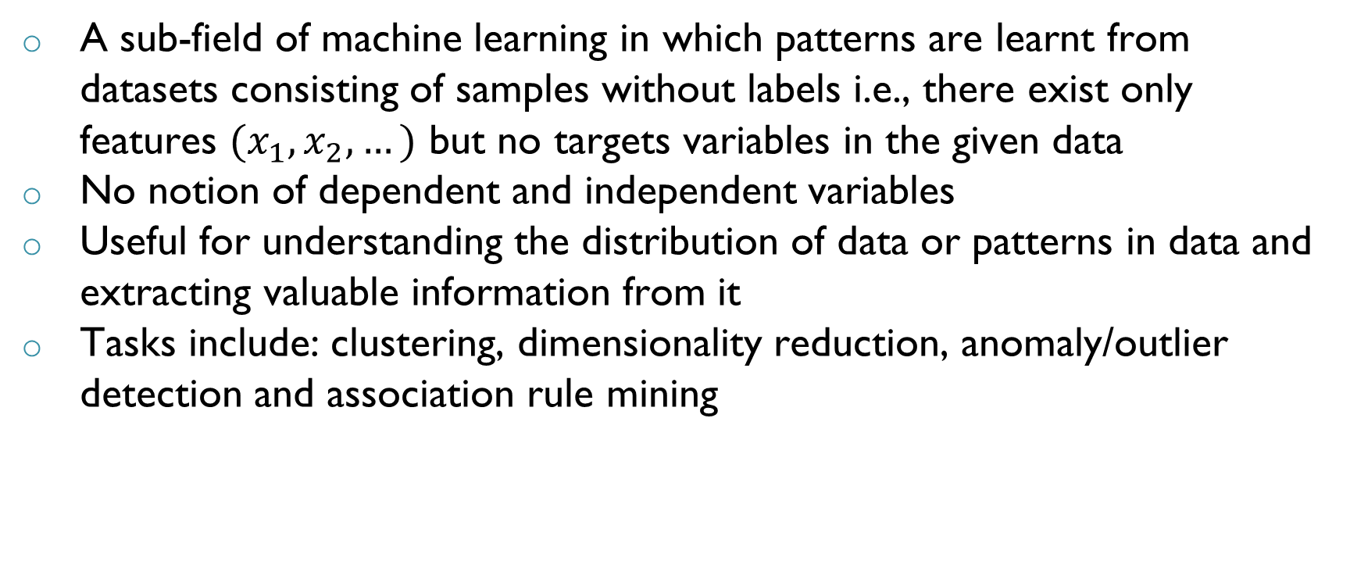
Introduction to Unsupervised Learning
A sub-field of machine learning in which patterns are learnt from datasets consisting of samples without labels i.e., there exist only features $(x_{1},x_{2},…)$ but no targets variables in the given data
No notion of dependent and independent variables
Useful for understanding the distribution of data or patterns in data and extracting valuable information from it
Tasks include: clustering, dimensionality reduction, anomaly/outlier detection and association rule mining

Slide 4
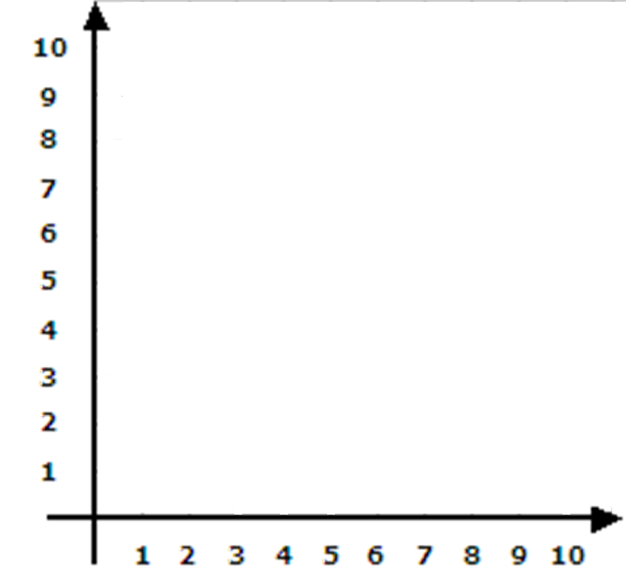
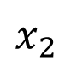
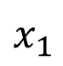
Clustering
$$x_{2}$$
Finding homogeneous subgroups within the data such that data points (samples) within a subgroup are similar
Subgroups are referred to as clusters
Similarity is decides based on some similarity measure
Gives an intuition about the structure and distribution of data
$$x_{1}$$

Slide 5
Clustering
$$x_{2}$$
Finding homogeneous subgroups within the data such that data points within a subgroup are similar
Subgroups are referred to as clusters
Similarity is decides based on some similarity measure
Gives an intuition about the structure and distribution of data
Useful in many applications where data points are to be grouped without any target labels
$$x_{1}$$

Slide 6
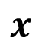
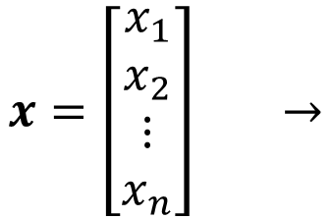
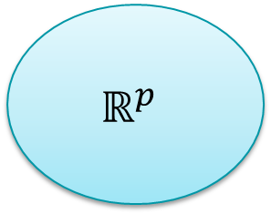
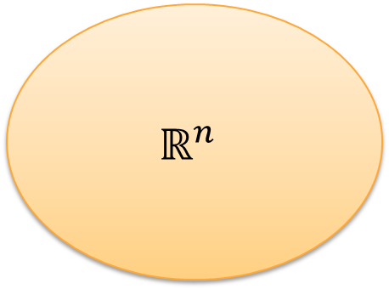
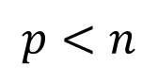
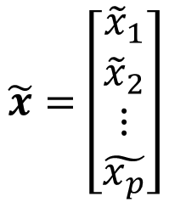
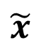
Dimensionality Reduction
$$p<n$$
Mapping features in a higher dimensional space to a lower dimensional space without loss of much information
Principal component analysis and autoencoders are unsupervised learning techniques used for dimensionality reduction
Useful in data compression and feature extraction
$$x=\left[\begin{matrix}x_{1} \\ x_{2} \\ ⋮ \\ x_{n}\end{matrix}\right] →$$
$$\tilde{x}=\left[\begin{matrix}{\tilde{x}}_{1} \\ {\tilde{x}}_{2} \\ ⋮ \\ \tilde{x_{p}}\end{matrix}\right]$$
$$x$$
$$\tilde{x}$$
$$ℝ^{n}$$
$$ℝ^{p}$$

Slide 7
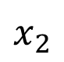
Anomaly/Outlier Detection
$$x_{2}$$
Finding unusual or unexpected data points in the dataset that differ from the rest
Anomalies occur rarely in data but detecting them is important
Works under the assumption that features of an outlier or anomaly point are significantly different from normal points
$$x_{1}$$

Slide 8
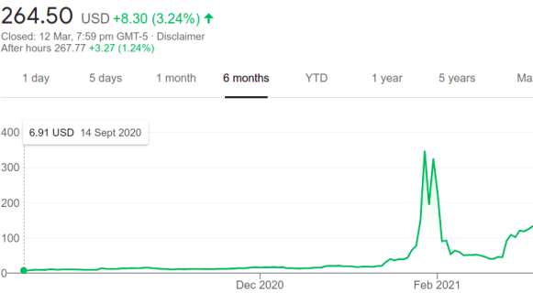
Anomaly/Outlier Detection
Finding unusual or unexpected data points in the dataset that differ from the rest
Anomalies occur rarely in data but detecting them is important
Works under the assumption that features of an outlier or anomaly point are significantly different from normal points
Anomaly or outlier detection in time series data is another important area of study

Slide 9
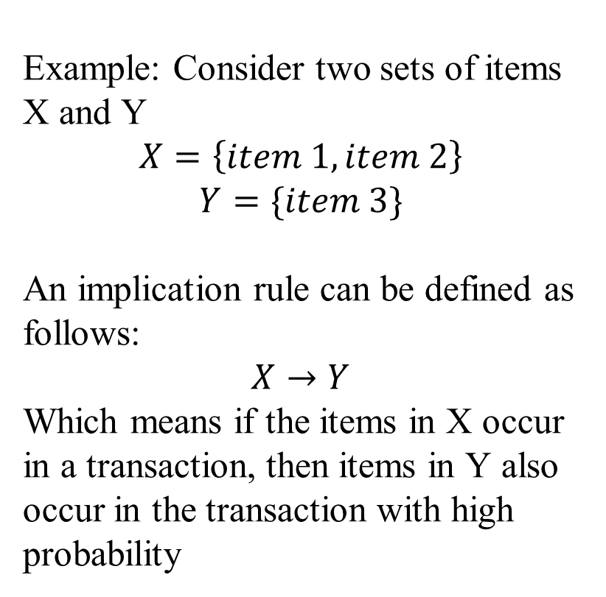
Association Rule Mining
Example: Consider two sets of items
X and Y
$$X=\left\{item 1, item 2\right\}$$
$$Y=\{item 3\}$$
An implication rule can be defined as follows:
$$X→Y$$
Which means if the items in X occur in a transaction, then items in Y also occur in the transaction with high probability
Unsupervised learning task for discovering relations (rules) between different variables in a dataset
Given a set of transactions, these rules predict the occurrence of an item in the transaction based on occurrence of other items in the transaction
More suitable for non-numeric, categorical data
Notes:
Association rule learning is a type of unsupervised learning methods that tests for the dependence of one data element on another data element and create appropriately so that it can be more effective. It tries to discover some interesting relations or relations among the variables of the dataset. It depends on several rules to find interesting relations between variables in the database.

Slide 10
Applications of Unsupervised Learning
Medical:
Categorising people into different groups based on different healthcare parameters and medical images
Based on the common conditions or diseases that a group of people may possess, certain conclusions about the condition or disease can be made
Association mining can also be used to form rules between symptoms and diseases which help doctors in diagnosis
Engineering:
Detecting faults (anomaly) in manufacturing or a process industry
Sudden changes in process parameters such temperature, pressure, power, vibration, etc. can be monitored and analysed using unsupervised learning techniques

Slide 11
Applications of Unsupervised Learning
Search Engines:
Grouping together search results based on a search phrase involves unsupervised learning
Google news uses unsupervised learning to categorize articles on the same story from various online news outlets
Image Grouping:
Grouping of pictures in a smart phone or in a social media account
Pictures with identical features are grouped together

Slide 12
Applications of Unsupervised Learning
Market Based Analysis:
Intelligent recommendations to consumers based on association rule mining
Data collected from supermarkets or e-commerce websites is mined for finding the associations between products which are frequently bought together
Consumer | Item 1 | Item 2 | Item 3
Consumer 1 | Eggs | Bread | Jam
Consumer 2 | Apple | Bread | Jam
Consumer 3 | Apple | Banana | Soup
Consumer 4 | Apple | Banana | Eggs
Notes:
The association rule learning is the important technique of machine learning, and it is employed in Market Basket analysis, Web usage mining, continuous production, etc. In market basket analysis, it is an adequate used by several big retailers to find the relations among items.

Slide 13

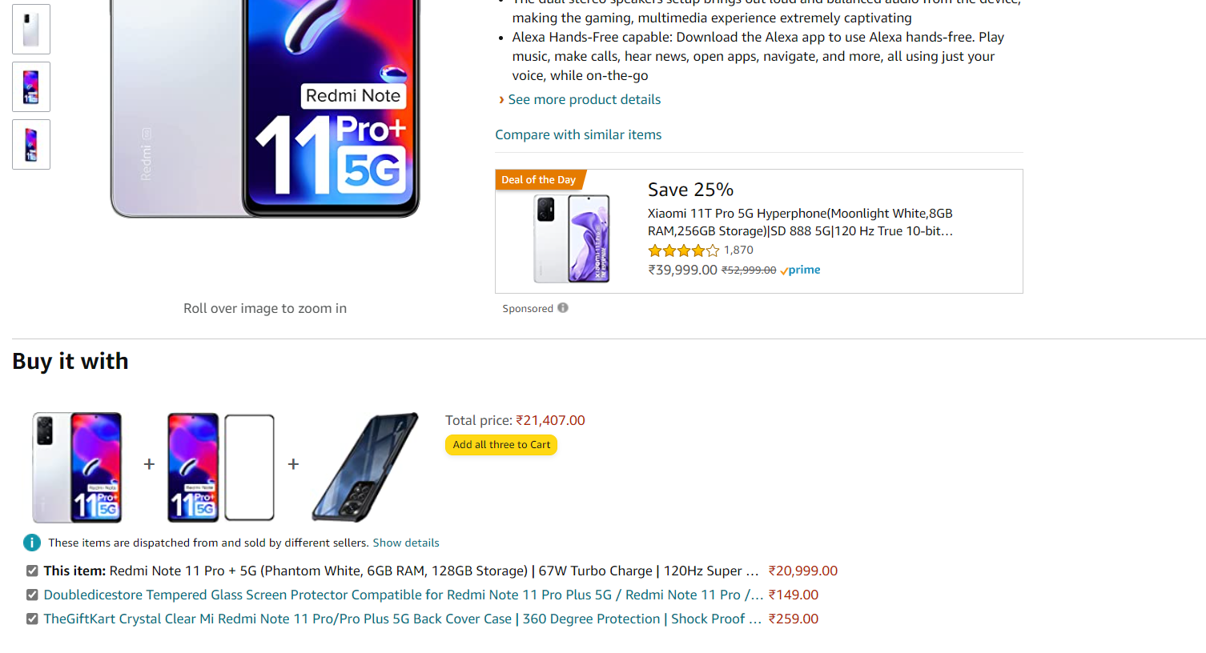
Applications of Unsupervised Learning
Market Based Analysis in Amazon website:

Slide 14
Clustering

Slide 15
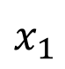
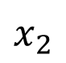
Clustering
$$x_{2}$$
Finding clusters within the data such that data points within a cluster are similar
Question: How to decide the similarity between different data points?
Similarity measures
Distance between points
Density of points
Probability of belonging to a distribution
$$x_{1}$$

Slide 16
Types of Clustering Algorithms

Slide 17
Types of Clustering Algorithms
Clustering algorithms can be categorised as follows based on the similarity metric used to cluster data:
Distance based metric:
Centroid based clustering
Hierarchical clustering
Density based metric:
Density based clustering
Probability based metric:
Distribution based clustering

Slide 18
Centroid based Clustering
$$x_{2}$$
Intuition: There is a centroid/centre for the cluster and all the points in the cluster are at a close distance to the centroid
In these algorithms, the number of clusters is to be decided apriori – a drawback
K-means clustering is the most popular algorithm among centroid based methods
$$x_{1}$$

Slide 19
Hierarchical Clustering
Typically used when the dataset is large
Constructs a hierarchy among all the data points and then based on the hierarchy puts them into different clusters
If a hierarchy exists, then it is used to cluster data otherwise distance metrics can be used to cluster data hierarchically
No need to choose the number of cluster apriori
Two Approaches:
Bottom Up approach – Agglomerative approach – most popular
Top down Approach – Divisive approach

Slide 20
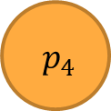
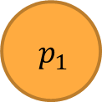


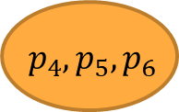
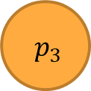
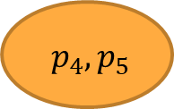
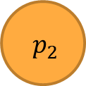
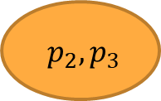
Hierarchical Clustering – Bottom Up Approach
Steps:
Each data point in the dataset is considered a cluster initially
Compute the distance between all clusters (centroid) based on some distance metric
Merge two clusters which are closest to one another
Repeat Steps 2 and 3 until desired level of clustering is obtained
Different heuristics can be used to determine when to stop clusters or after desired number of clusters are obtained
$$p_{1}$$
$$p_{2}$$
$$p_{3}$$
$$p_{4}$$
$$p_{5}$$
$$p_{6}$$
Level 1
Level 2
$$p_{2},p_{3}$$
$$p_{4},p_{5}$$
Level 3
$$p_{4},p_{5},p_{6}$$
Level 4

Slide 21
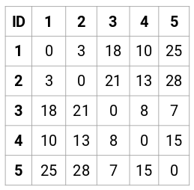
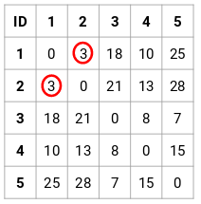
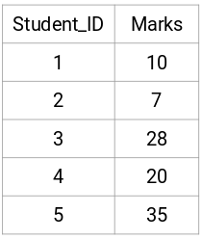
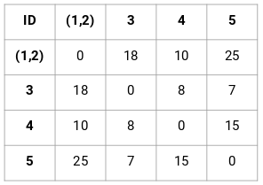
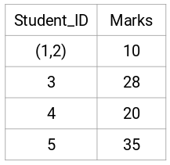
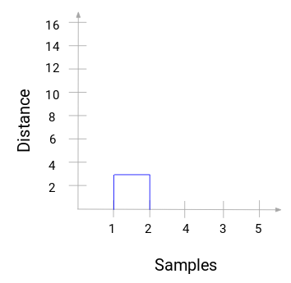
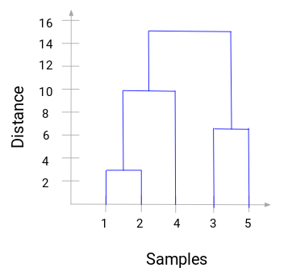
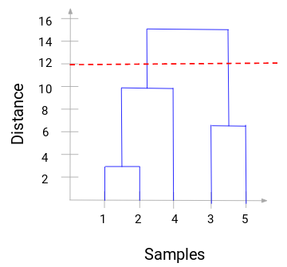
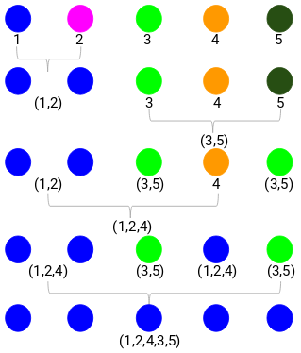
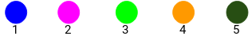
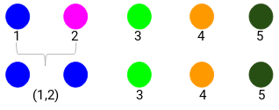

Slide 22
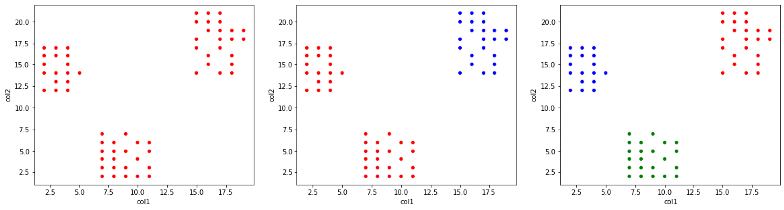
Hierarchical Clustering – Top Down Approach
Exactly opposite to Bottom-Up Approach
Steps:
Consider all the data points to be in one single cluster
Partition the cluster into two clusters which are not similar based on a distance metric
Repeat until desired level of clustering is obtained
Image source: Medium.com

Slide 23

Hierarchical Clustering – Visualisation
Hierarchy of clusters can be represented using a dendrogram
Image source: Medium.com

Slide 24
Distance Measures
Distance measure is a function which gives distance between two data points
If the function returns 0, then the two data points are equivalent
If distance is low, points can be considered to be similar and vice-versa
Most used distance measures are as follows:
Euclidian distance
Manhattan distance
Cosine Distance or Similarity

Slide 25
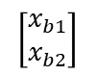
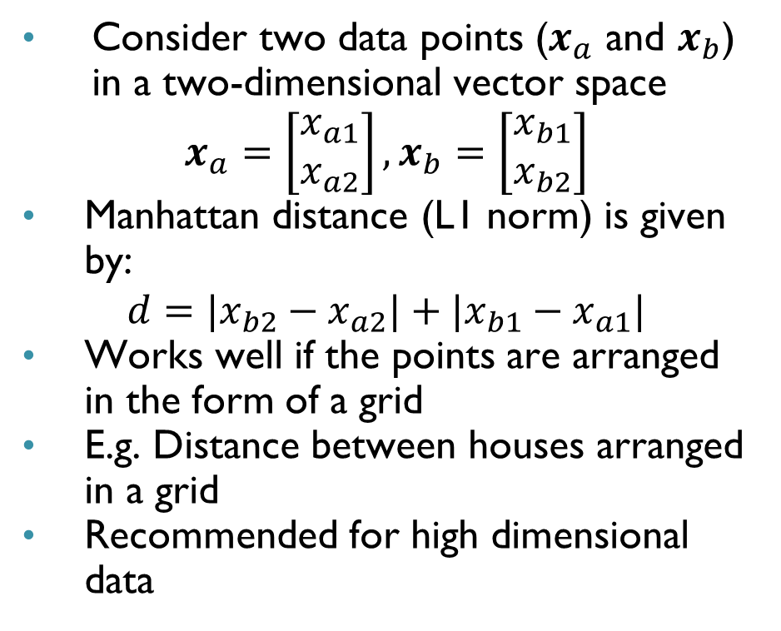
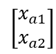
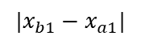
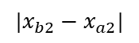
Manhattan Distance
$$x_{2}$$
Consider two data points ($x_{a}$ and $x_{b}$) in a two-dimensional vector space
$$x_{a}=\left[\begin{matrix}x_{a1} \\ x_{a2}\end{matrix}\right], x_{b}=\left[\begin{matrix}x_{b1} \\ x_{b2}\end{matrix}\right]$$
Manhattan distance (L1 norm) is given by:
$$d=|x_{b2}−x_{a2}|+|x_{b1}−x_{a1}|$$
Works well if the points are arranged in the form of a grid
E.g. Distance between houses arranged in a grid
Recommended for high dimensional data
$$\left[\begin{matrix}x_{b1} \\ x_{b2}\end{matrix}\right]$$
$$|x_{b2}−x_{a2}|$$
$$\left[\begin{matrix}x_{a1} \\ x_{a2}\end{matrix}\right]$$
$$|x_{b1}−x_{a1}|$$
$$x_{1}$$
Ref: The Surprising Behaviour of Distance Metrics in High Dimensions | by z_ai | Towards Data Science

Slide 26
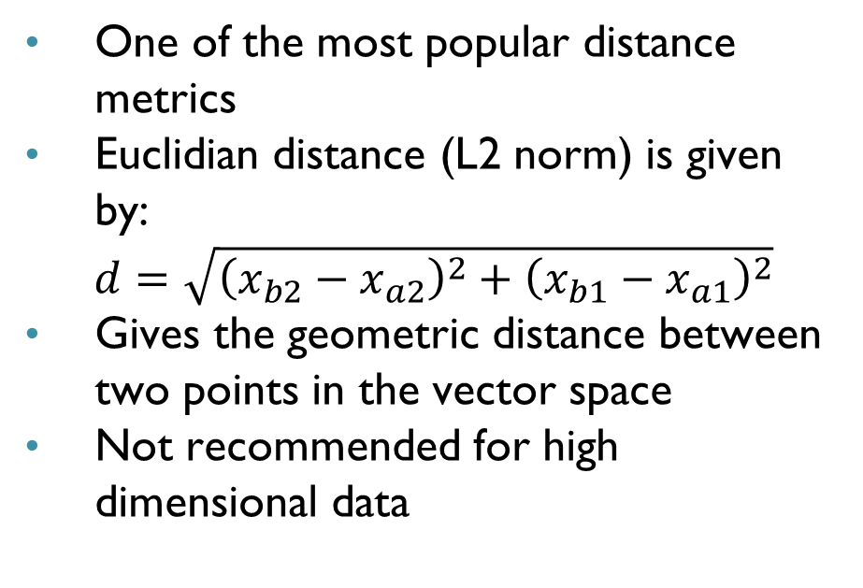
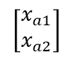
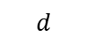
Euclidian Distance
$$x_{2}$$
One of the most popular distance metrics
Euclidian distance (L2 norm) is given by:
$$d=\sqrt{{\left(x_{b2}−x_{a2}\right)}^{2}+{\left(x_{b1}−x_{a1}\right)}^{2}}$$
Gives the geometric distance between two points in the vector space
Not recommended for high dimensional data
$$\left[\begin{matrix}x_{b1} \\ x_{b2}\end{matrix}\right]$$
$$d$$
$$\left[\begin{matrix}x_{a1} \\ x_{a2}\end{matrix}\right]$$
$$x_{1}$$
Ref: The Surprising Behaviour of Distance Metrics in High Dimensions | by z_ai | Towards Data Science

Slide 27
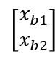
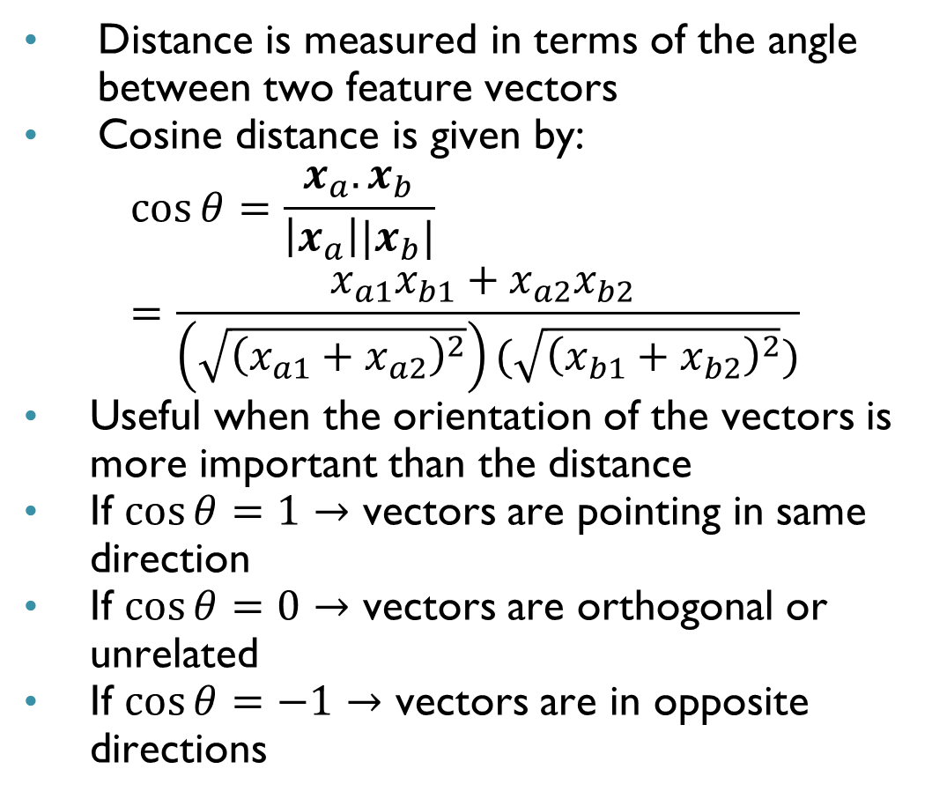
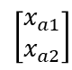
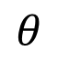
Cosine Distance
$$x_{2}$$
Distance is measured in terms of the angle between two feature vectors
Cosine distance is given by:
$$\cos{θ=\frac{x_{a}.x_{b}}{\left|x_{a}\right||x_{b}|}}=\frac{x_{a1}x_{b1}+x_{a2}x_{b2} }{\left(\sqrt{{\left(x_{a1}+x_{a2}\right)}^{2}}\right)(\sqrt{{\left(x_{b1}+x_{b2}\right)}^{2}})}$$
Useful when the orientation of the vectors is more important than the distance
If $\cos{θ}=1→$ vectors are pointing in same direction
If $\cos{θ}=0→$ vectors are orthogonal or unrelated
If $\cos{θ}=−1→$ vectors are in opposite directions
$$\left[\begin{matrix}x_{a1} \\ x_{a2}\end{matrix}\right]$$
$$\left[\begin{matrix}x_{b1} \\ x_{b2}\end{matrix}\right]$$
$$θ$$
$$x_{1}$$

Slide 28
Density and Distribution based Clustering
Notes:
Good: can detect arbitrary shapes, not very sensitive to noise, supports outlier detection, complexity is kind of okay, beside K-means the second most used clustering algorithm.
Bad: does not work well in high-dimensional datasets, parameter selection is tricky, has problems of identifying clusters of varying densities (→SSN algorithm), density estimation is kind of simplistic (→does not create a real density function, but rather a graph of density-connected points

Slide 29

Density based Clustering
Note: Distance based methods assume that the clusters are in specific shape (spherical or elliptical)
Density based: No assumption on shape of cluster
Intuition: Groups data points with high density into one cluster
Points not in high density region are not clustered and are considered outlier points
Useful:
When clusters are of varied shapes but are densely populated
to separate outliers from the points in dense regions
Clusters after Density based clustering
Notes:
K-Means forms spherical clusters only. This algorithm fails when data is not spherical ( i.e. same variance in all directions). K-Means algorithm is sensitive towards outlier. Outliers can skew the clusters in K-Means in very large extent.

Slide 30


Density based Clustering
DBSCAN-most popular density based clustering technique Density-Based Spatial Clustering of Applications with Noise
Example: To separate high valued customers from a large group of customers based on their purchase patterns
DBSCAN applied on whole data
Annual
Electronics
Purchases
(scaled)
Annual Grocery purchases (scaled)
Non-clustered data represents
high valued customers
Notes:
Partitioning methods (K-means, PAM clustering) and hierarchical clustering work for finding spherical-shaped clusters or convex clusters. In other words, they are suitable only for compact and well-separated clusters. Moreover, they are also severely affected by the presence of noise and outliers in the data.

Slide 31
Distribution based Clustering
Groups data points based on their likely hood of belonging to the same probability distribution
Each cluster is assumed to be drawn from a different distribution (different parameters)
Distribution needs to be assumed – Gaussian, Binomial, etc.
Can be used only when it is known that the data comes from well known distributions
Gaussian mixture model is an example of distribution based clustering algorithm

Slide 32
K-Means Clustering

Slide 33

K-Means Clustering
$$x_{2}$$
A centroid based clustering technique which uses Euclidian distance as distance metric
$N$ data points are clustered into $k<N$ clusters
A data point will belong to cluster to whose centre it is nearest
Centre in this case is the mean vector of all data points (sample vectors) in the cluster
$$x_{1}$$

Slide 34

Step to K-Means Clustering
Select the number of clusters ($k$) into which the data is to be grouped
Randomly initialise the centres of each cluster (Heuristics can be used) or this initialisation can be done multiple times
Compute the Euclidian distance from each centre to each of the data points in the dataset
Group each data point in the cluster to whose centre it is closest
After grouping, re-compute the centre of each cluster by taking the mean of all data points
Repeat the steps 3 to 5 until the cluster centres don’t change much
Mathematically, the sum of distances of the data points to the cluster centres are getting minimised

Slide 35
K-Means Clustering - Example

Slide 36

K-Means Clustering - Example
Step 1: Let $k=2.$ Randomly choose two points as the cluster centers
Step 2: Compute the distances and group the closest ones
 | Mean x | Mean y
Centre 1 | 1 | 1
Centre 2 | 3 | 3
Sample | distance 1 | distance 2 | Cluster
1 | 0 | 2.8284271 | 1
2 | 0.7071068 | 2.1213203 | 1
3 | 0.5 | 3.2015621 | 1
4 | 0.2828427 | 2.8425341 | 1
5 | 3.1144823 | 0.3162278 | 2
6 | 3.111077 | 0.7992496 | 2
7 | 3.0805844 | 0.5385165 | 2
8 | 2.8284271 | 0 | 2

Slide 37
K-Means Clustering - Example
Step 3: Compute the new centres (mean of samples in respective clusters) and repeat step 2
Step 4: If change in mean is negligible or no reassignment then stop the process
 | Mean x | Mean y
Centre 1 | 1.075 | 1.05
Centre 2 | 3.095 | 3.145
Sample | distance 1 | distance 2 | Cluster
1 | 0.0901388 | 2.9983412 | 1
2 | 0.6189709 | 2.2912988 | 1
3 | 0.5550901 | 3.374174 | 1
4 | 0.3132491 | 3.0083301 | 1
5 | 3.0254132 | 0.2098809 | 2
6 | 3.0301691 | 0.7425968 | 2
7 | 2.9905058 | 0.5320244 | 2
8 | 2.7400958 | 0.1733494 | 2

Slide 38

K-Means Clustering - Illustration
Source: wikipedia

Slide 39


Determining Number of Clusters (k)
Elbow method is generally used to estimate the optimal value of k for k means clustering
Value of $k$ is varies from 2-10 (say) and for each value of k, the sum of distance of samples from their centres is computed and plotted
In the plot, the point where the curve plateaus is an indicator of the optimal number of clusters
Sum of distances

Slide 40
Silhouette score

Slide 41


Silhouette score
$$x_{2}$$
Cluster 2
(Nearest to cluster 1)
To evaluate the quality of clusters created using clustering algorithms
It measures how well samples are clustered with other samples that are similar
Following distances are required to calculate the silhouette score:
Mean distance between a data point (sample) and all other data points in the same cluster – denoted by $a$
Mean distance between a data point (sample) and all other data points of the nearest cluster - denoted by $b$
Cluster 1
$$x_{1}$$

Slide 42

Silhouette score
Silhouette score, S, is calculated for each sample using the following formula:
$$S=\frac{b−a}{max⁡(a,b)}$$
Silhouette score varies from $−1 to 1.$
If the score is $1$, the cluster is dense and well-separated than other clusters.
A value near $0$ represents overlapping clusters with samples very close to the decision boundary of the neighboring clusters.
A negative score $[−1, 0]$ indicates that the samples might have got assigned to the wrong clusters
Silhouette scores can be plotted and be used to select the most optimal value of the K (no. of clusters) in K-means clustering.

Slide 43
Advantages and Disadvantages of Unsupervised Learning
Advantages:
Useful for exploratory data analysis
Data can be classified into groups without any labels
Useful as a pre-processing step to supervised learning tasks
Disadvantages:
Cannot be used for predictive analysis because there is no model relating output to input
If the dataset is large, it takes lot of time for clustering
High risk of inaccurate results

Slide 44
Summary
Unsupervised learning involves techniques which extracts useful information from unlabelled data
Clustering, dimensionality reduction, association mining and anomaly detection are well known unsupervised learning tasks
Many types of clustering exist based on different metrics such as distance, density and probability
K-mean clustering is the simplest and most popular among clustering techniques
K-means clustering clusters the data into k clusters based on Euclidean distance of the points to the centre (mean) of the cluster
Silhouette score measures the quality of clusters that are formed for distance-based clustering methods

Slide 45

THANK YOU

